Slide 1
CS 445
Stance Detection
Serhan Emre Telatar - 29034
Nida Kayaduman -29063
Zeynep Merve Yaman - 28876
Bengi Ada Tüfeckci - 30720

Slide 2
Introduction
Objective
To develop accurate stance detection models using the SemEval-2016 Stance Dataset
Current Progress
Dataset was selected
Roadmap and workload distributions were determined
Starting on preprocessing

Slide 3
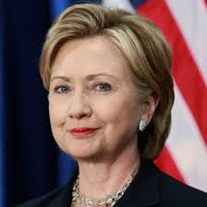


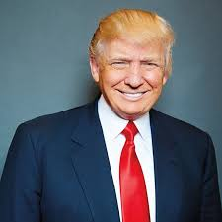


Dataset Selection
SemEval-2016 Stance Dataset
Output
Topics:
Hillary Clinton
Donald Trump
Legalization of Abortion
Atheism
Feminist Movement
Climate Change
Stance:
Favor
Against
Neutral

Slide 4
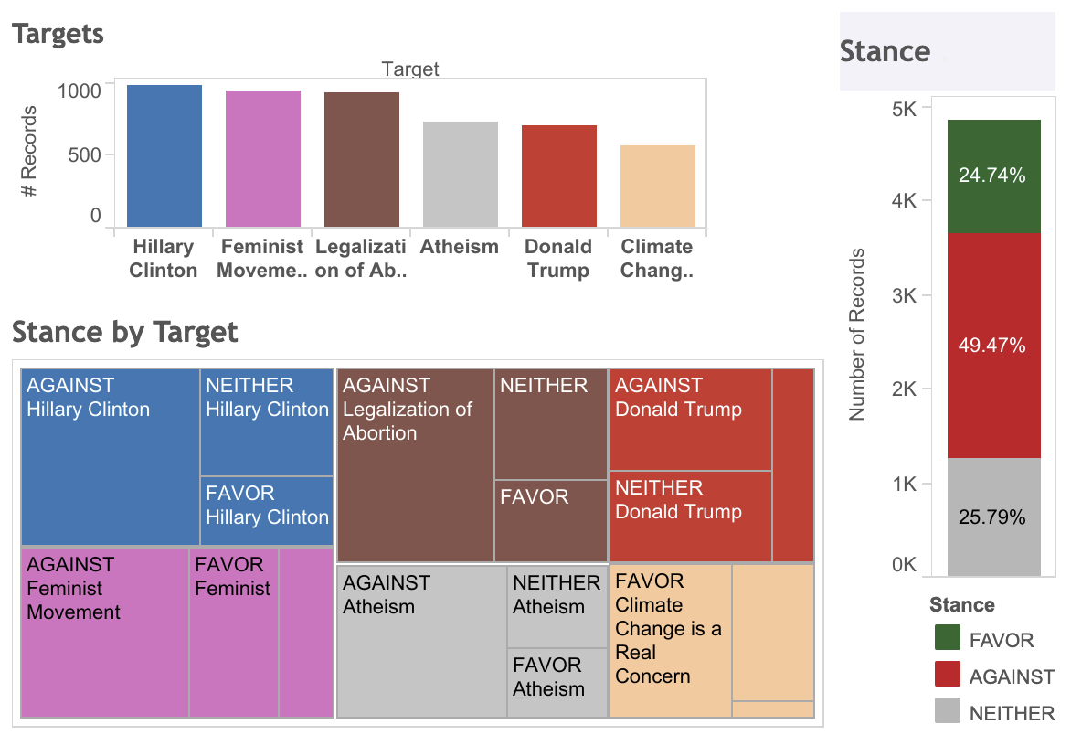
Why this Dataset?
Relevance
Diversity
Structure
s

Slide 5
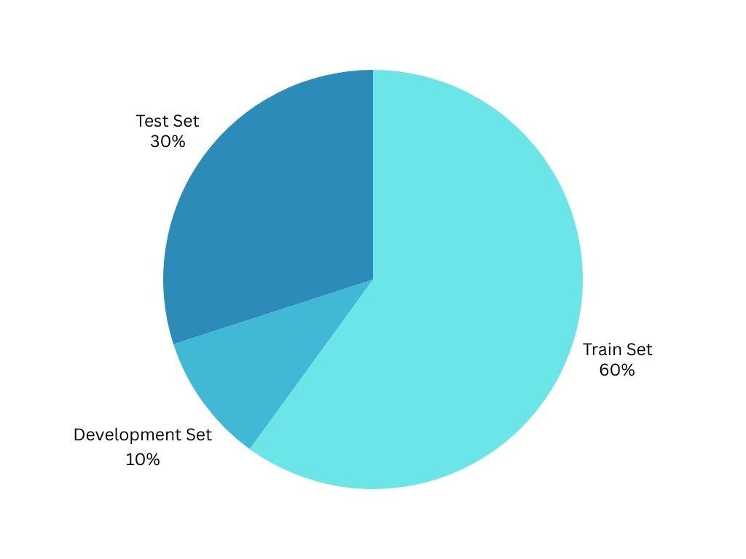
Dataset Split
Train Set: (60%)
Development Set: (10%)
Test Set: (30%)

Slide 6
Approach Plan
Replicate the model with the highest F-score in SemEval-2016 Task 6, which is the work of Mohammad et al. 2017. They used a SVM with the features: word and character n-grams, the presence of the target of interest in the tweet, and Word2Vec Skip-gram word embeddings.
Improve their results by using BERT word embeddings with SVMs, Naive Bayes, and FeedForward and Recurrent Neural Networks.

Slide 7

Next Steps
SVM Model Development
BERT Model Implementation
Some tasks like report writing, presentation preparation and data preprocessing will be divided.

Slide 8
THANKS

